Slide 1
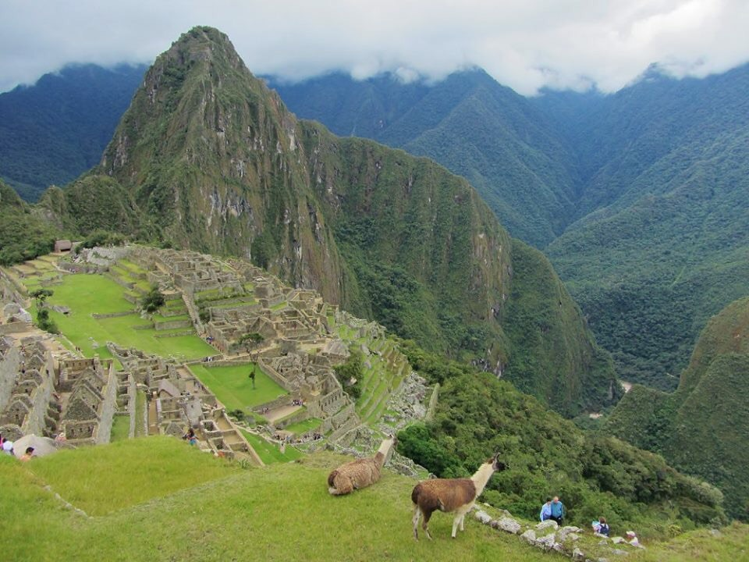
Tarjetas
BLANK SIDE
Picture of YOU – I need to clearly see your face and be able to distinguish who you are.
LINED SIDE
Your name (what you will be called in my class and last name)
What is your favorite thing to do in the whole world?
Is there anything I should know about you?
Do you have any questions for me?

